Slide 3
Section title

Slide 4
Preferred text layout (no bullets), 2 color
Main topic 1: size 40pt
Size 20pt for the subtopics
Size 20pt for the subtopics
Main topic 2: size 40pt
Size 20pt for the subtopics
Size 20pt for the subtopics
Main topic 3: size 40pt
Size 20pt for the subtopics
Size 20pt for the subtopics

Slide 5
Preferred text layout (no bullets)
Main topic 1: size 40pt
Size 20pt for the subtopics
Size 20pt for the subtopics
Main topic 2: size 40pt
Size 20pt for the subtopics
Size 20pt for the subtopics
Main topic 3: size 40pt
Size 20pt for the subtopics
Size 20pt for the subtopics

Slide 6
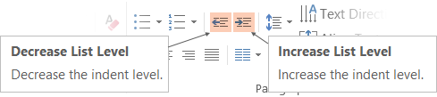
Adjusting list levels
Main topic 1: size 40pt
Size 20pt for the subtopics
Size 20pt for the subtopics
Main topic 2: size 40pt
Size 20pt for the subtopics
Size 20pt for the subtopics
Main topic 3: size 40pt
Size 20pt for the subtopics
Size 20pt for the subtopics
Use the “Decrease List Level” and “Increase List Level” tools on the Home Menu to change text levels.
Try this:
Place your cursor in any row of text to the left that says “Size 20pt for subtopics”
Next click the Home tab, and then on the “Decrease List level” tool. Notice how the line moves up one level.
Now try placing your cursor in one of the “Main topic…” lines of text. Click the “Increase List Level” tool and see how the text is pushed in one level
Use these 2 tools to adjust your text levels as you work

Slide 7
Bullet points layout with subtitle Subtitle
Example of a bulleted slide with a subhead
Set the slide title to “Sentence case”
Set subheads to “Sentence case”
Hyperlink style
www.microsoft.com

Slide 8
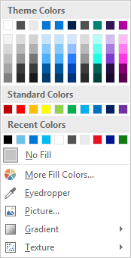
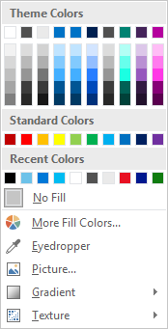
Slide palette info
The PowerPoint palette for this template has been built for you and is shown below. Avoid using too many colors in your presentation.
Select the 4th color from the left for subheads and 1st level non-bulleted text color, or wherever “color” text is preferred over the default black/white text
Accent colors 1-6 – (6 Theme Colors to the far right)
Text
Dark 2
Accent 1
Accent 2
Accent 3
Accent 4
Accent 5
Accent 6
Use Accent 1 as the main accent color. Use Accent 2 and Accent 3 when additional colors are needed.
Use Accents 4-6 sparingly – only when more colors are necessary.

Slide 9
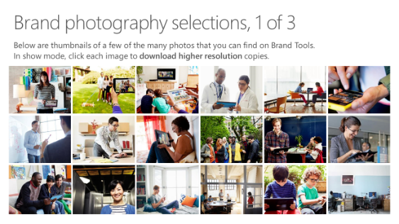
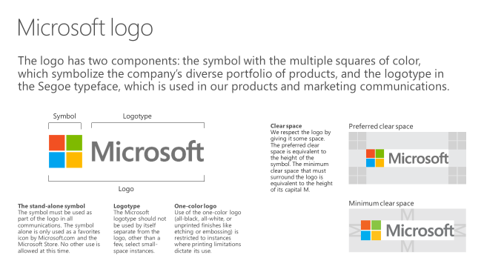
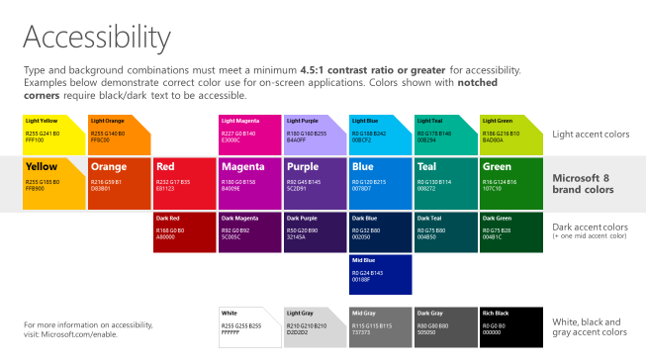
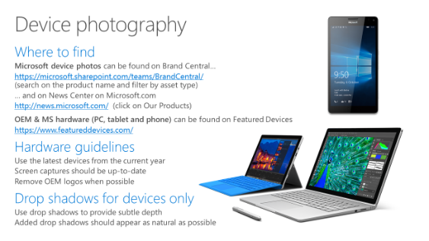
Microsoft brand guidelines
Looking for more slide resources?
Brand guidelines for PowerPoint templates is a separate slide deck that provides an overview of the Microsoft brand, guidelines, resources, tips and much more.
A few of the slides are shown at right.
Download from: https://microsoft.sharepoint.com/teams/BrandCentral/Pages/Presentations.aspx

